Slide 1
Inventory Management System -
A project Overview
Luke Conway - QA Consultant

Slide 2
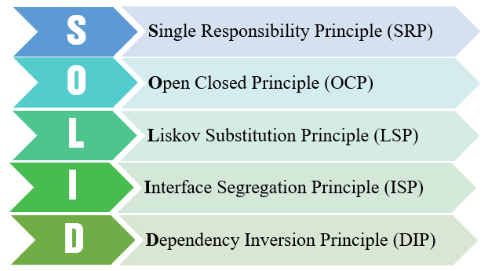
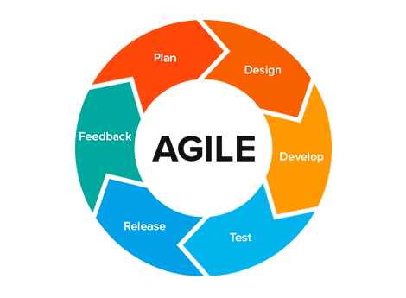
The Journey of a Fledgeling Consultant
5 weeks of intense but fun training, culminating from nothing to now - A full project.
Java basics though to more intermediate knowledge.
Agile development - How it works, why it works and how to use it.
Continuous Integration Pipelines.
SQL and database management and design - Entity Relationship Diagrams
The S.O.L.I.D. Programming Principles
Testing and Test Driven Development

Slide 3
Introduction to the Project
Inventory Management system for proving our knowledge on what we have learnt and how to apply it.
Written in Java using the Eclipse IDE
Integrating MySQL functionality to interact with a Database
CRUD Statements
DML (Data management Language)
DDL (Data Definition Language)
CI Pipeline incorporation
GitHub and Git
Jenkins
SonarQube
Nexus
Maven
Testing with JUnit

Slide 4
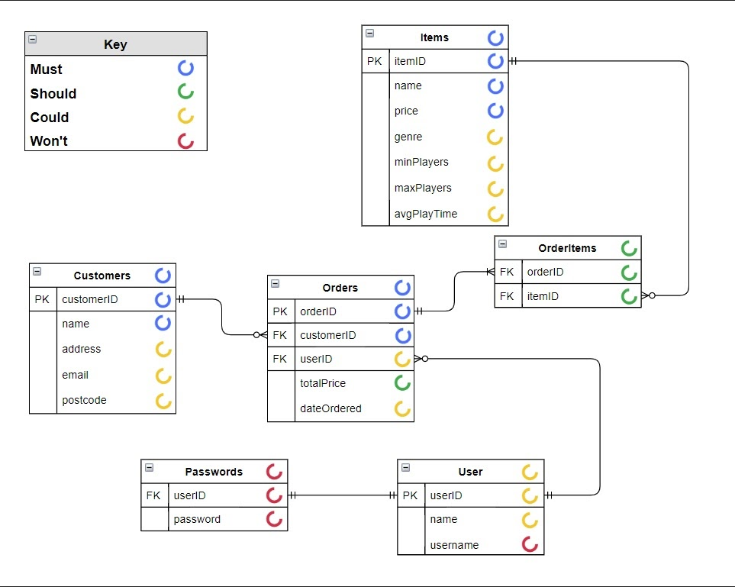
Initial Plans
Planning for the project used multiple approaches:
Trello - Project Road Map
GitHub
Repository setup
Project Kanban Board
MySQL Database ERD
Project Risk Assessment

Slide 5
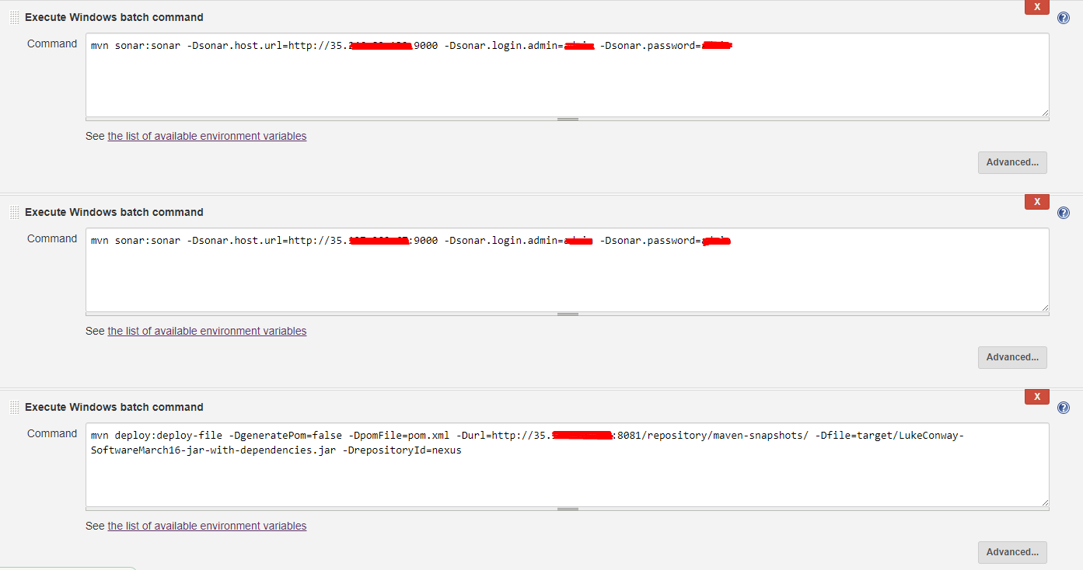
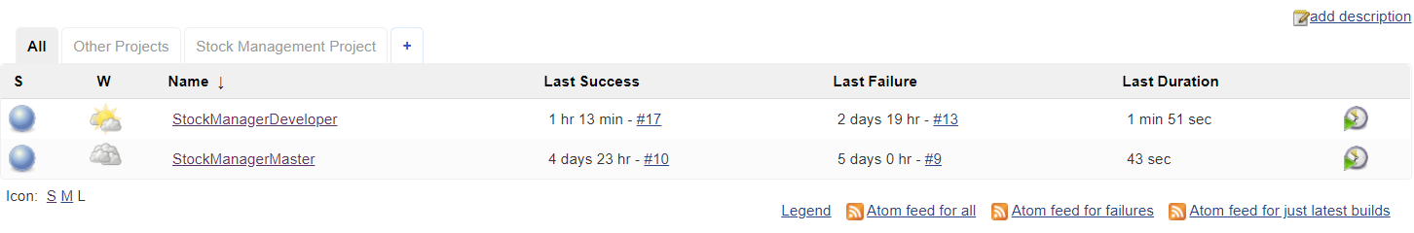
CI (Continuous Integration) Pipeline
The CI Pipeline used multiple software to setup and integrate it fully:
Eclipse
GitHub
Jenkins
Maven
Nexus

Slide 6
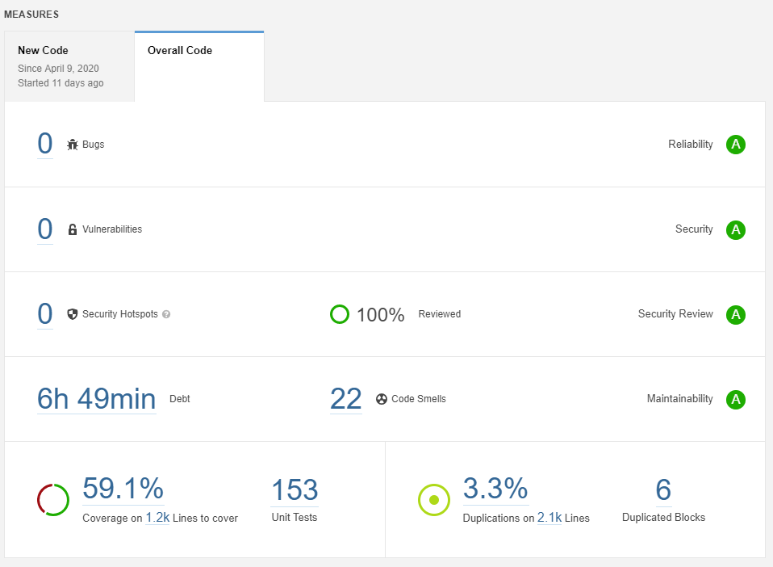
Sonarqube
Scanned project for bug, vulnerabilities and ‘Code smells’
Applying this knowledge, gained from each push allowed for overview of potential improvements to code.
Ranged from anywhere to simple readability issues all the way to severe security flaws.
Used after every daily code push.

Slide 7
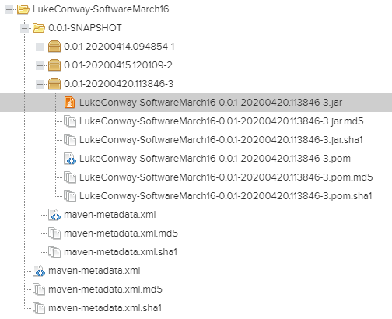
Nexus
Stores all master branch artifacts in a repository everytime updates are pushed onto the master branch.
Allows for a backlog of previous versions for easy rollback and version control.
Also stores each version fully built thanks to Jenkins sending the project via Maven.

Slide 8
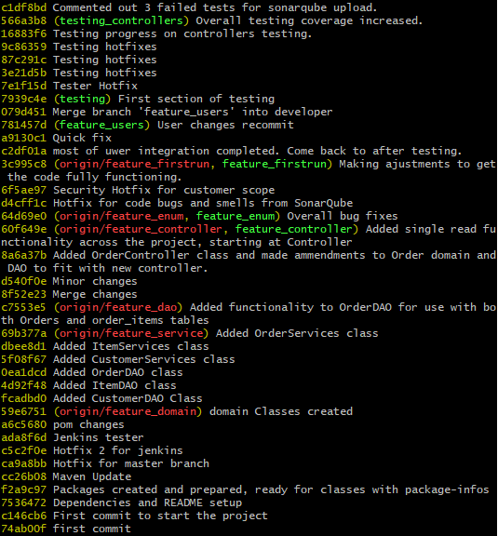
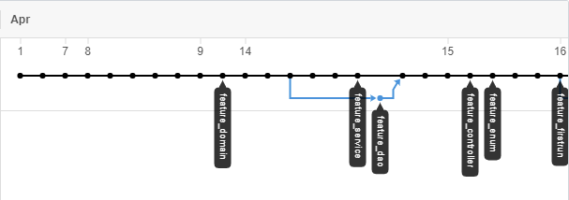
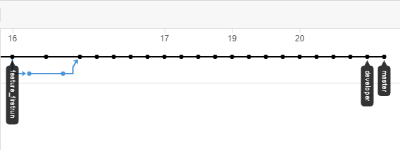
GitHub
Source code repository and version control.
Using branches allowed for easy code backups and access with good systems to manage each change
Perfect system for recovering from mistakes or bad coding changes

Slide 9
Project Demo Time!

Slide 10
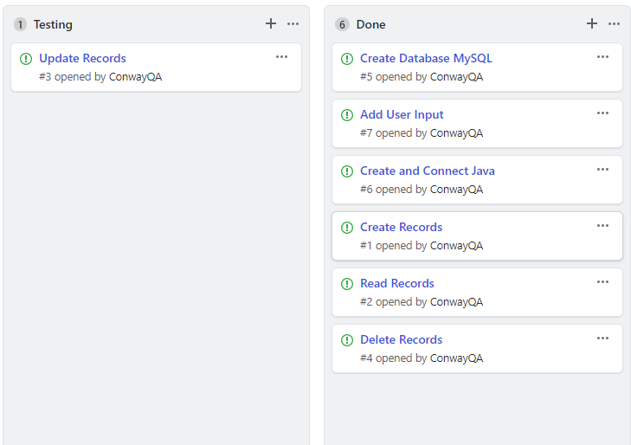
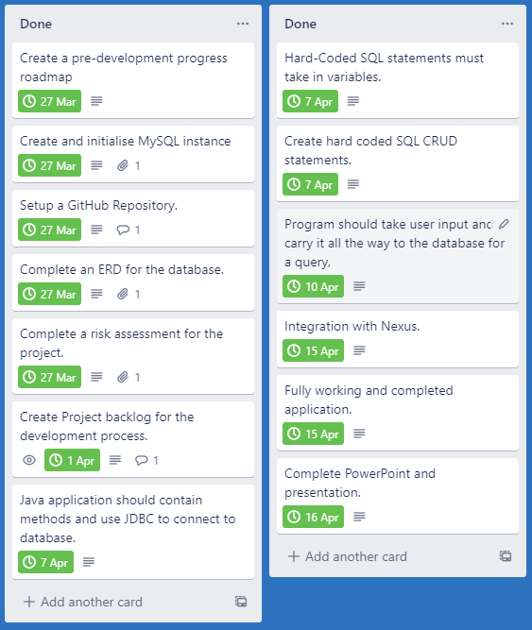
Sprint Review
After going through our coding sprint, as shown by the GitHub Kanban board (above) and the Trello board (left) A great deal of progress was made towards full completion.
All basic functionality was implemented and then mostly tested. Enough to add User functionality with Login functions and its own CRUD statements.

Slide 11
Retrospect & Conclusion
Over all the project went well, though not smoothly.
Planning was quick and efficient, and effort here save a lot more effort further down.
An excellent learning experience but lack of knowledge became a large obstacle to overcome.
The importance of testing was demonstrated.
Fully implemented CI pipeline showed its vast uses.
Future emphasis on Time keeping and prioritisation of features.

Slide 12
Any Questions?

